Slide 1
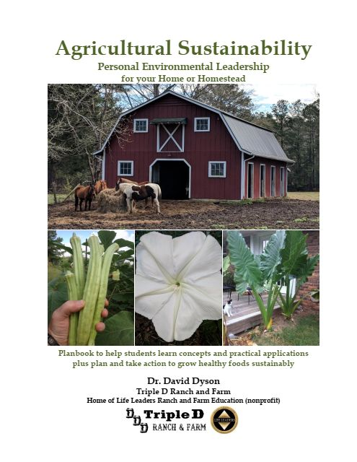
Guest lectures in UM classes of Professors Caplow and Crider with Dr. David Dyson, Life Leaders Institute and Triple D Ranch & Farm
Learn principles and best practices you can use—now and after college— to grow good food you like save money help the planet expand your capacities as a person….
Plan for your best-self to put into actions ideas you value—for this seminar, this course, college, profession…
Take at least 1 seed from the jar—take 3 if you want to try planting them.
Take your planbook and sample farm flier.

Slide 2
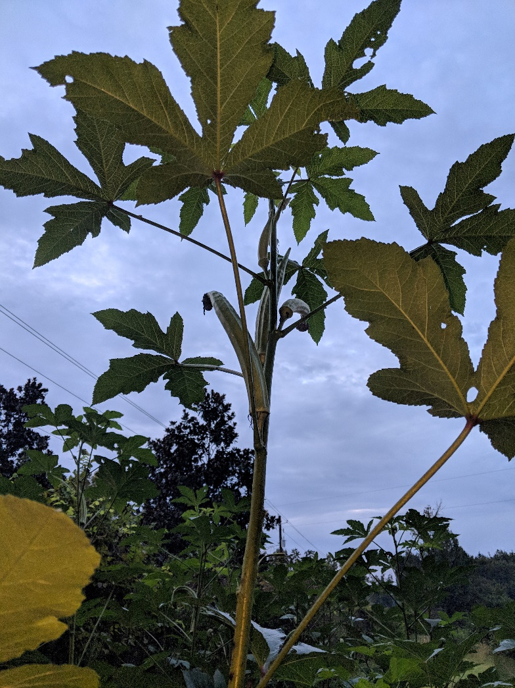
Name of plant?
Country of origin?
Uses?
Where are the seeds?
Benefits of this plant?
When to plant in Central Alabama?
When to harvest?
How to harvest and store seeds?

Slide 3
Mission
To inspire knowledge and action applying principles and best practices of healthy sustainable agriculture and personal environmental leadership.
Vision
Students grow healthy food using the best of traditional practices plus innovation.
Students write plans to implement actions on values and lessons learned.
Students write Plans for School & Life and universities teach and reward this best practice.
Goals
Present principles and practical applications you can use in your plan.
Help students improve Plans for School & Life with applications for ag.
Share possibilities as well as examples of what’s working and not so you can pick actions you value—now and after college.

Slide 4
Preview
Your Planbook and Plan (page 17)
Ranch & Farm flier (handout) shares a sample of what you may consider
Operationalize to improve your performance
Meet some of the ranch animals—the main WHY for the farm/plants
Plants and Paradigms
Ideas for what you could do now, soon
What will you do a result our work today?

Slide 5
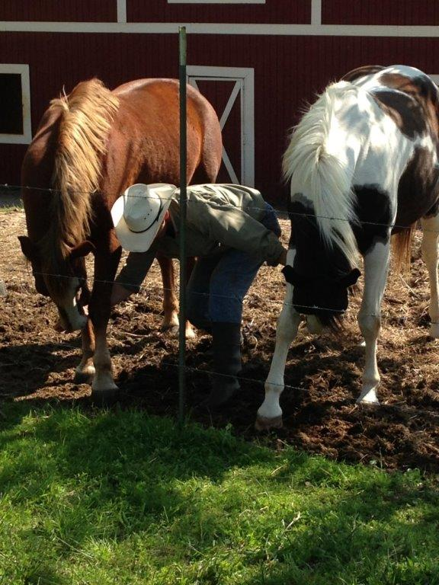
Meet some of the animals at
Triple D Ranch and Farm
the main WHY for more land,
which added motivation for growing more plants
Ag on a homestead often includes animals and plants.
Patriot and Indy bowing=>
(learned by giving them a carrot behind their front legs)

Slide 6
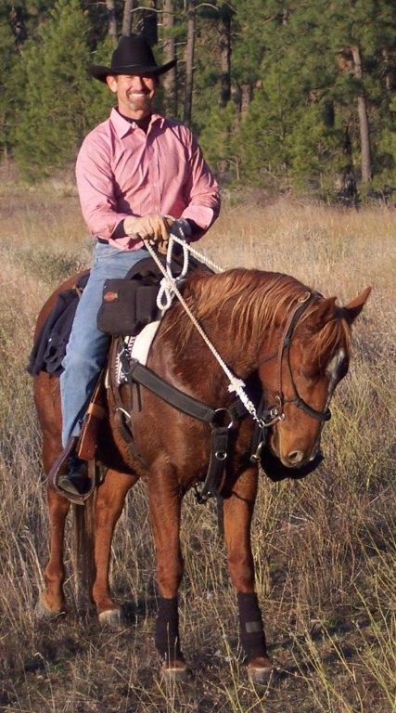
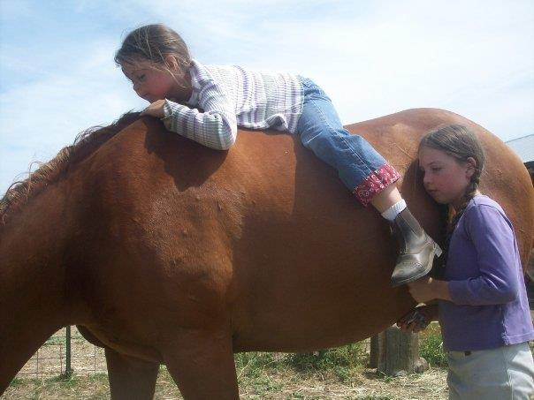
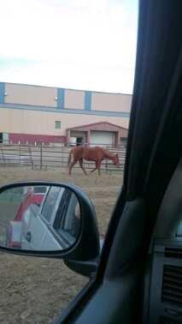
Star of the Bar (2003 American Quarter Horse)
<=Washington State, our first big ride.
With her new little girls (for 6 years).
South Dakota on our trip home to Alabama.

Slide 7
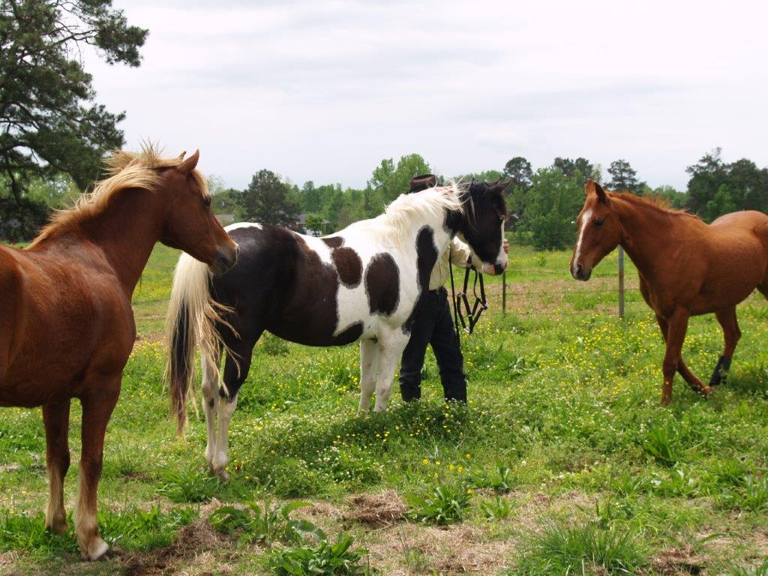
Star reunited with her herd: Indy, (her adopted son) and Patriot.
Notice her ears (part of horsemanship to observe)
Indy was a colt when last with Star—now bigger, he returned to following her, putting her #2 in the herd pecking order.

Slide 8
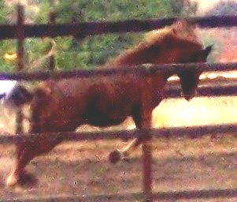
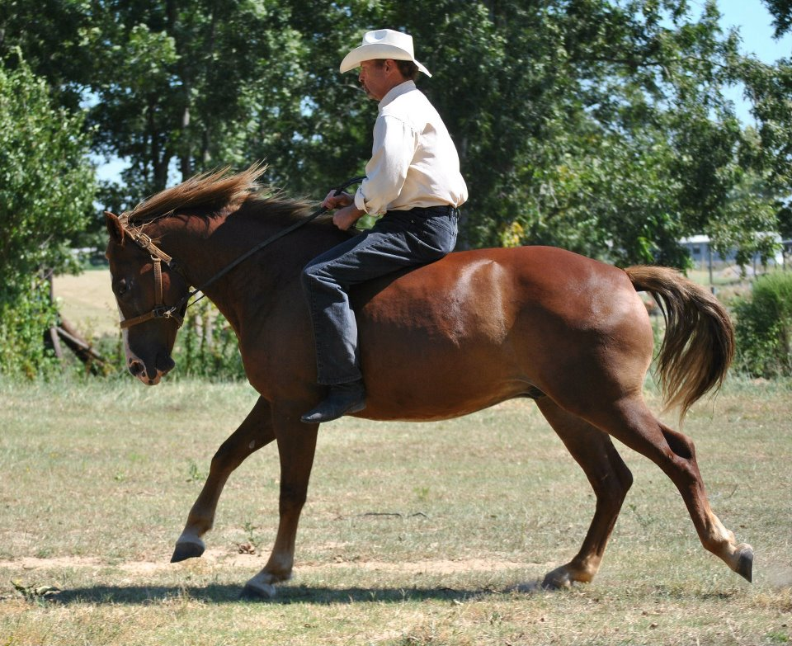
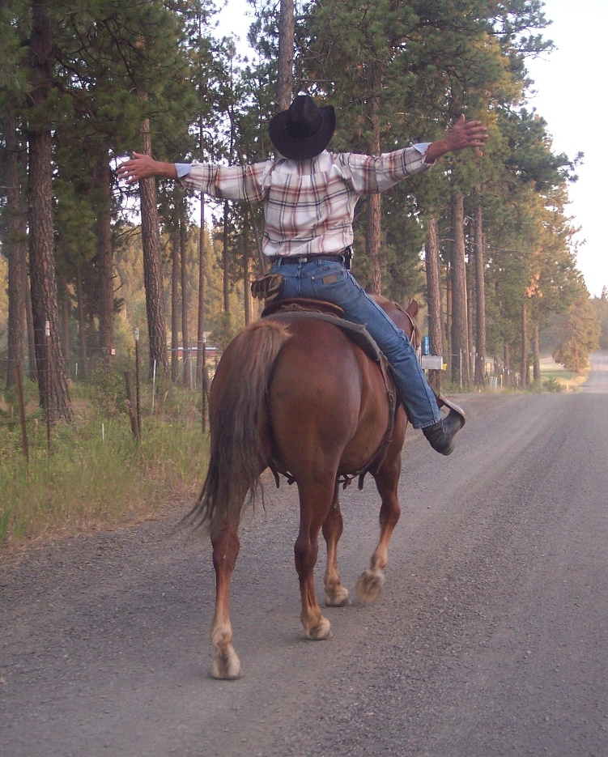
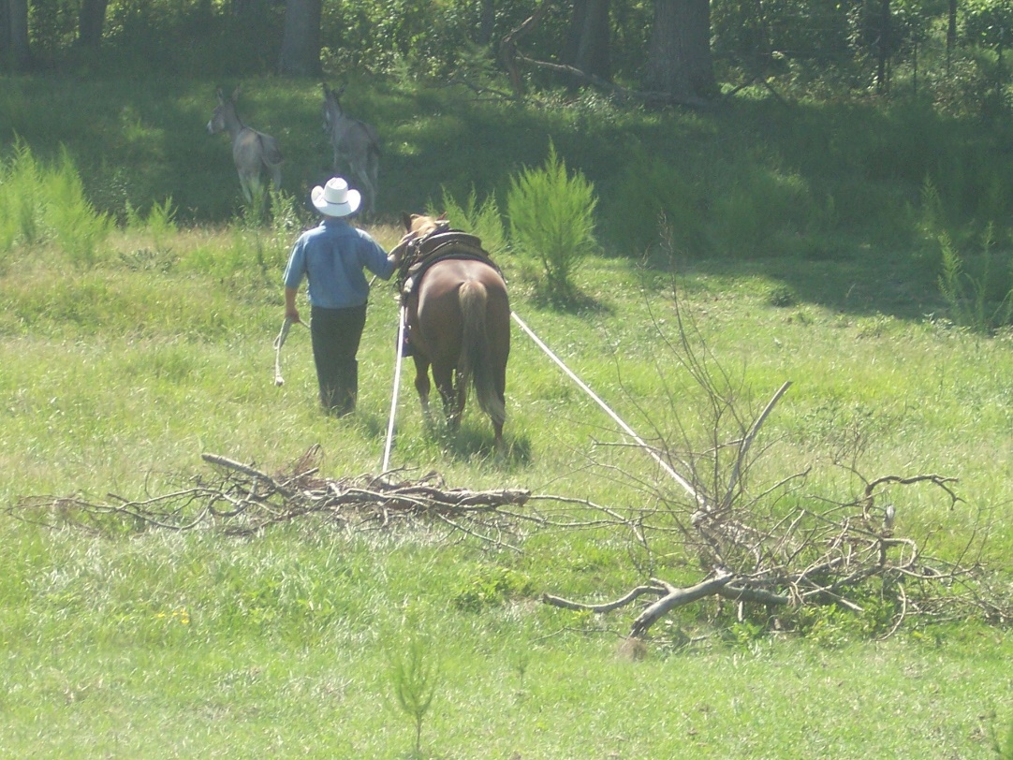
Patriot (Anakus Flynn)
(2001 Morgan Horse, WA)
Day 1 new home.
Carrying David (after lots of trust building)
Last ride in Washington.
Pulling limbs.

Slide 9
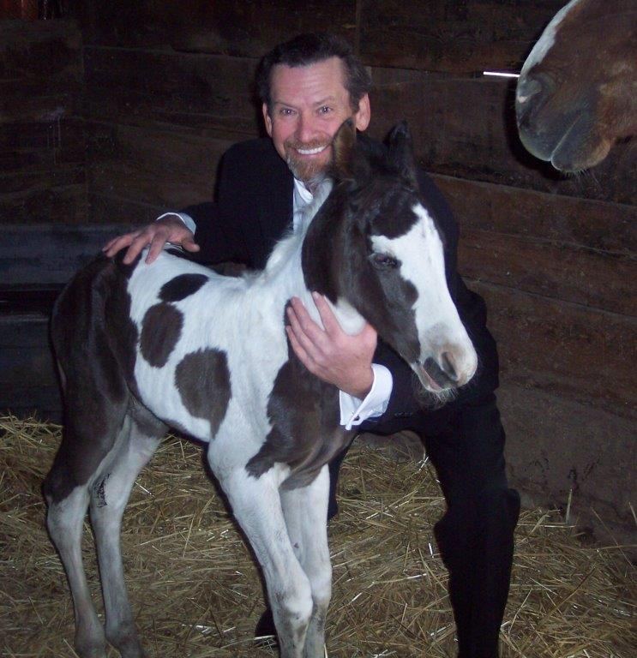
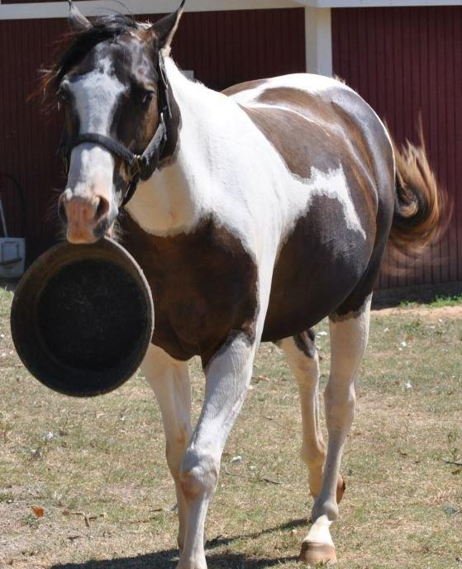
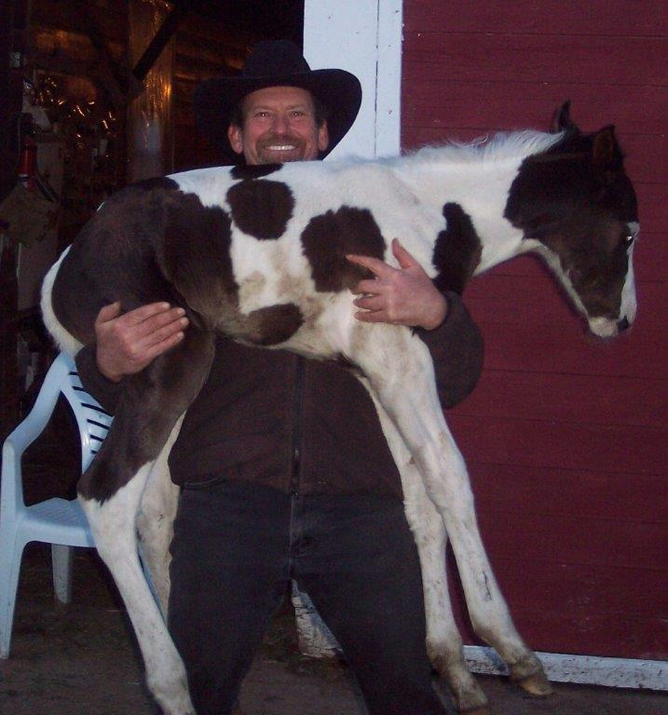
Indian Legend (Indy)
(Paint, Born Washington)
<=2 hours after birth.
1st week, picking him up for conditioning and trust building.
He brings his bowl when hungry☺

Slide 10
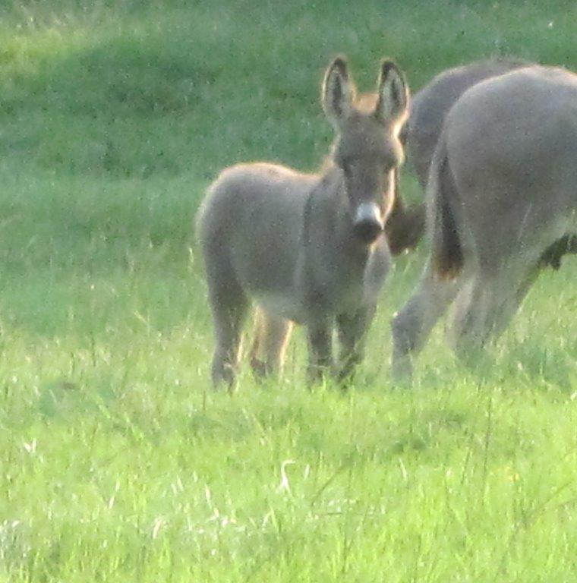
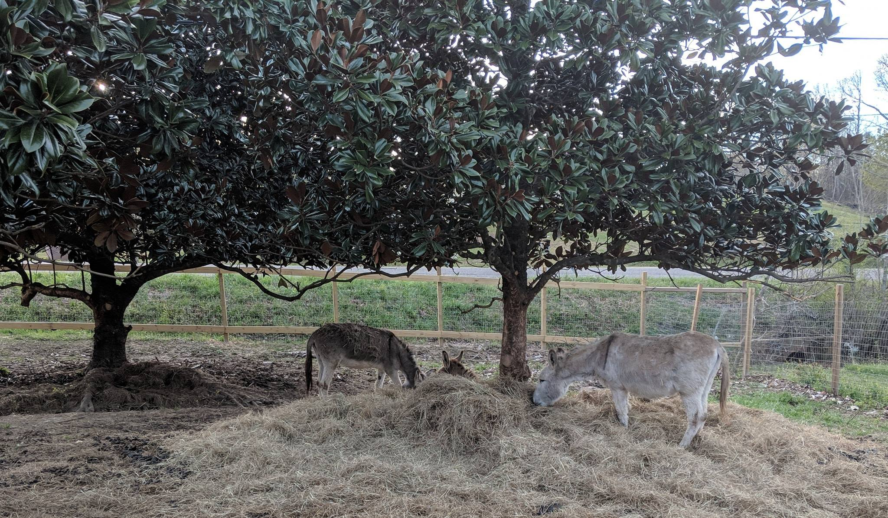
Jill (part miniature donkey).
<=when a baby the first time I saw her after her herd broke in to my pasture for food.
She lives with grandmother (June) and the patriarch (Honk).
They often eat and sleep in the pile of hay under the Magnolia trees (with canopy raised so they can walk under for shelter).

Slide 11
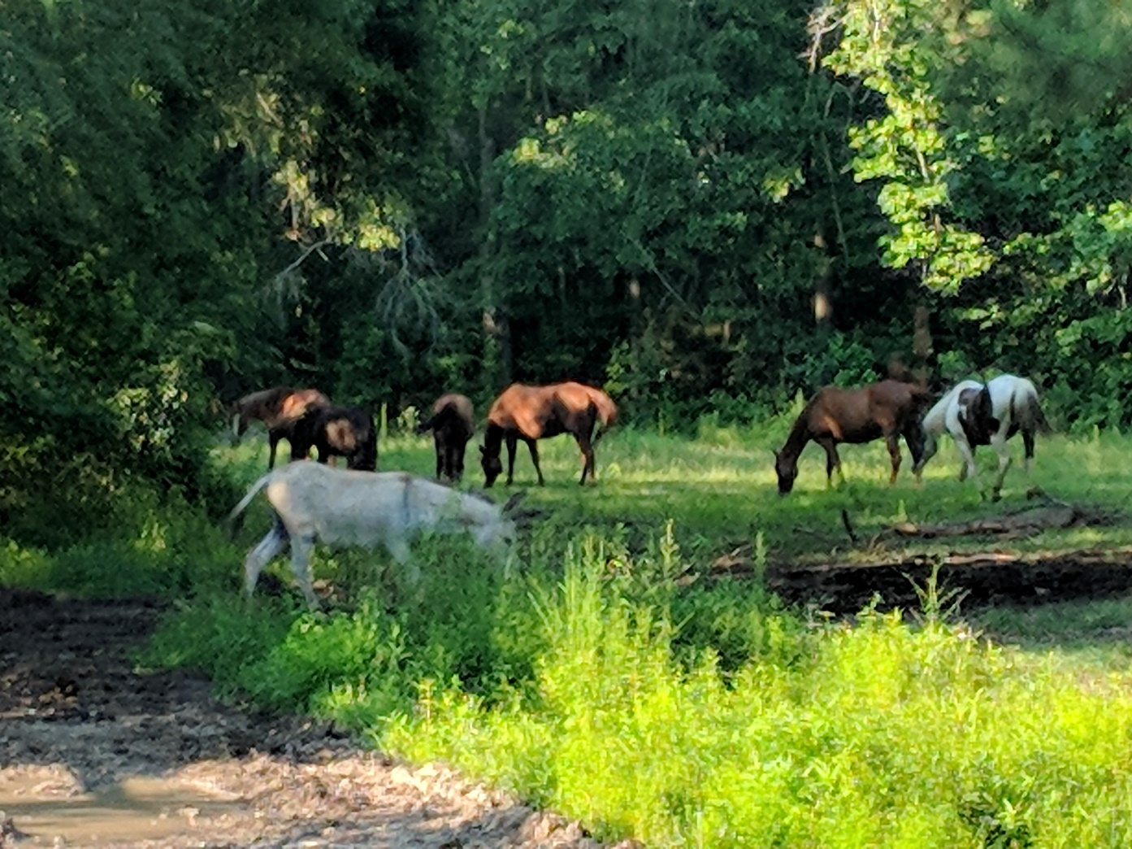
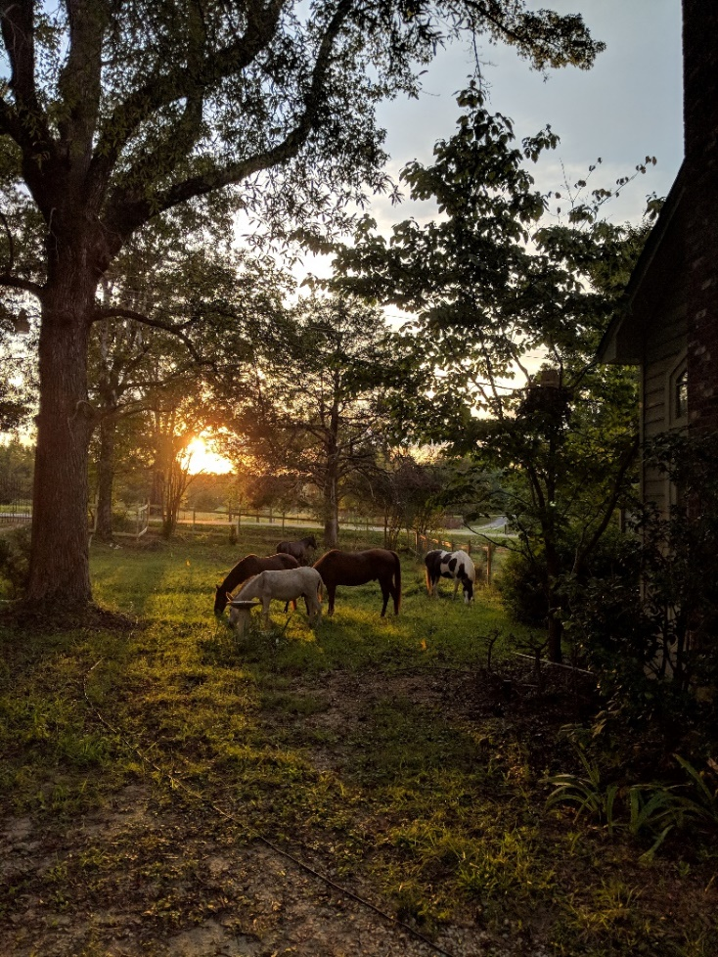
More of the herd.
They mow the pastures and cut the grass.

Slide 12
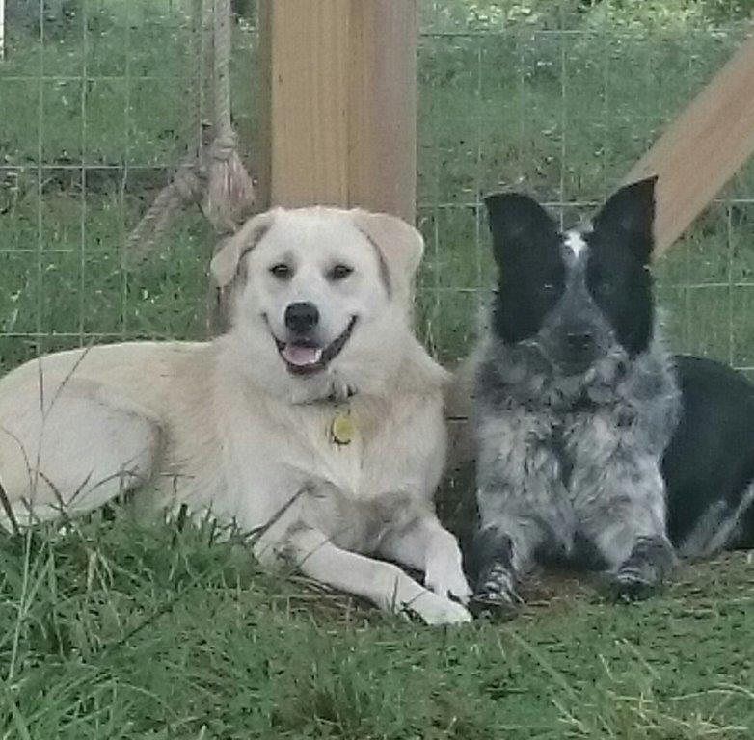
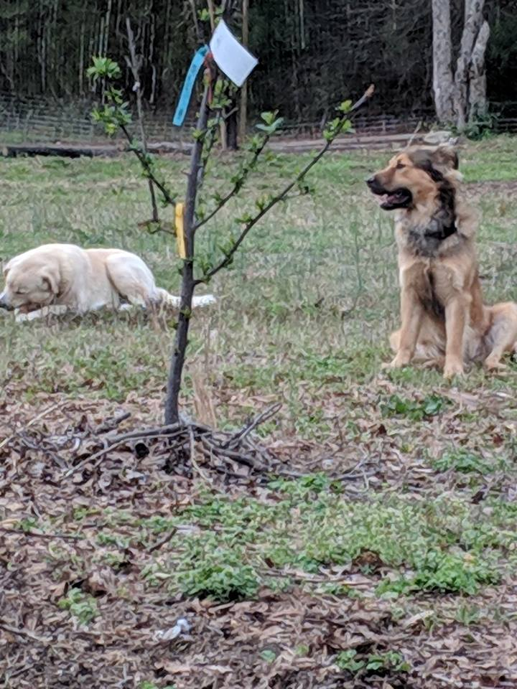
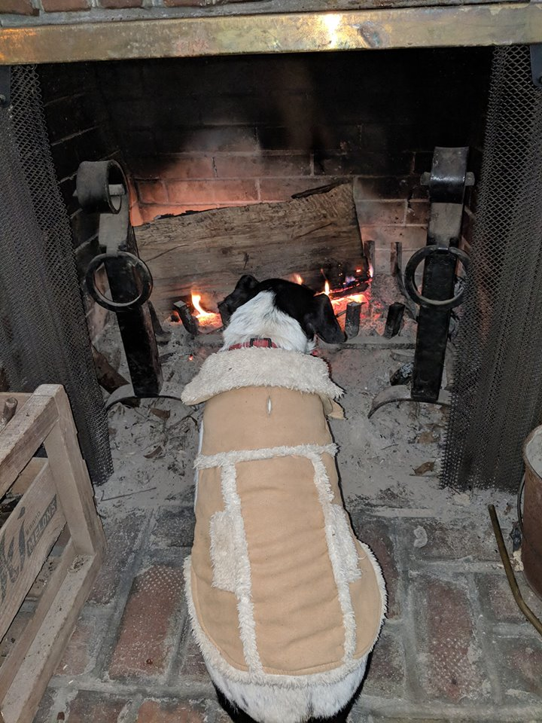
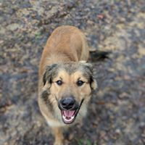
Adopted after being abandoned (great dogs)—it’s best to adopt almost every time.
Buck (part Pyrenees & guard dog)
Cowgirl (part Border Collie, herding dog)
Chief (part German Shepherd)
Lady
(part Jack Russell & “champion lap dog”)

Slide 13
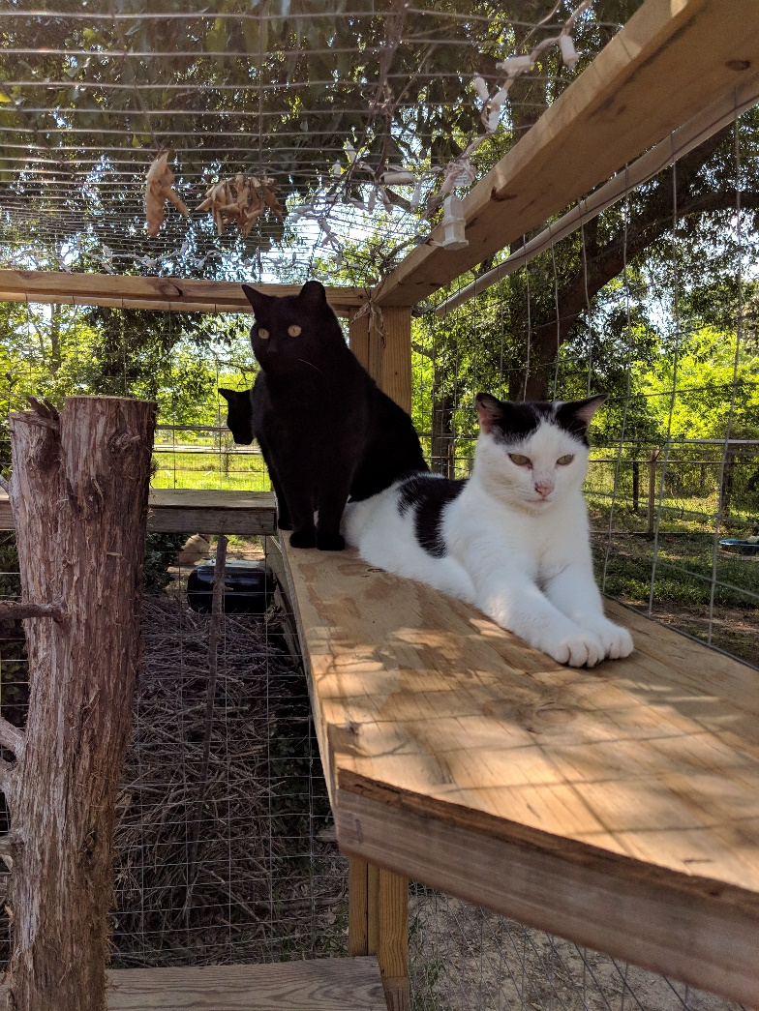
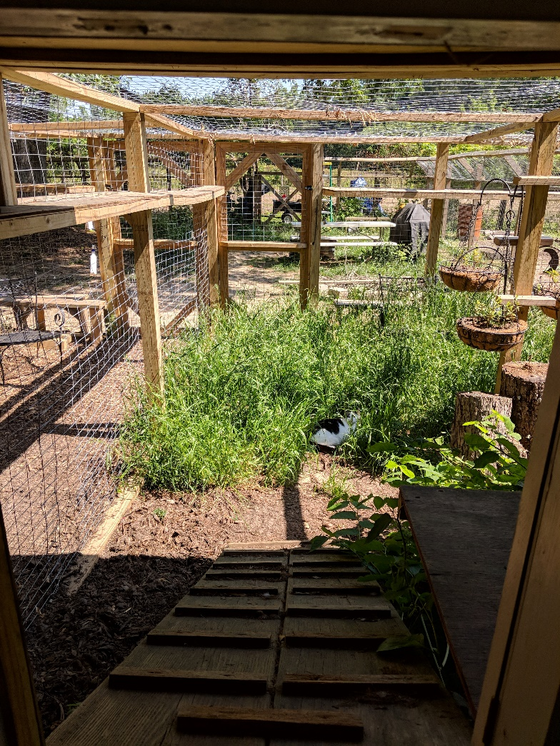
Cats (3 of 8 siblings and cousins) in their
Freedom Fence
They can go outside with fencing over the top to protect them from predators and dangers and walk up to the screened porch.
Use: 4x4 posts, 2x4 framing, 2x4” welded wire…wooden ramp to screened porch where they eat and sleep…inside through cat door when they want, especially cold.
Catwalks at 5’ high above the dogs though all are friends.

Slide 14
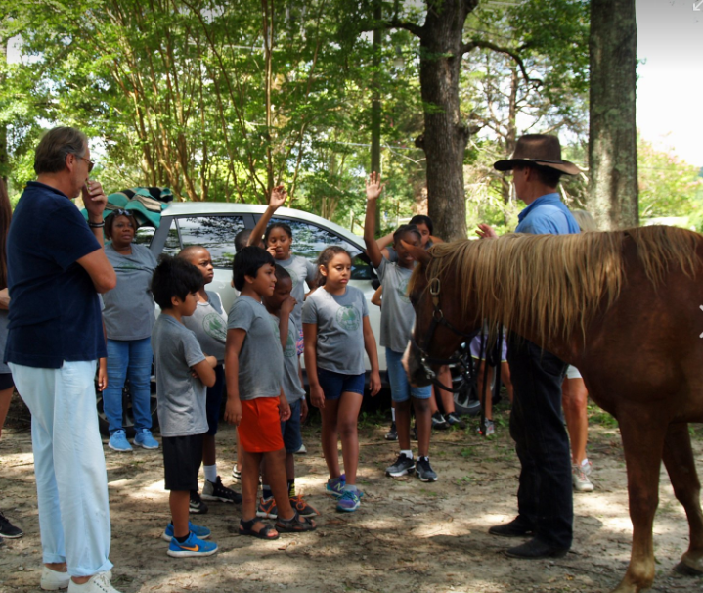
Life Leaders Ranch Day
Patriot helping me teach a beginner clinic with students, ages 6-12,
Camp Rockhurst.
They also enjoyed a picnic, discussed plans for life, fished, hiked….

Slide 15
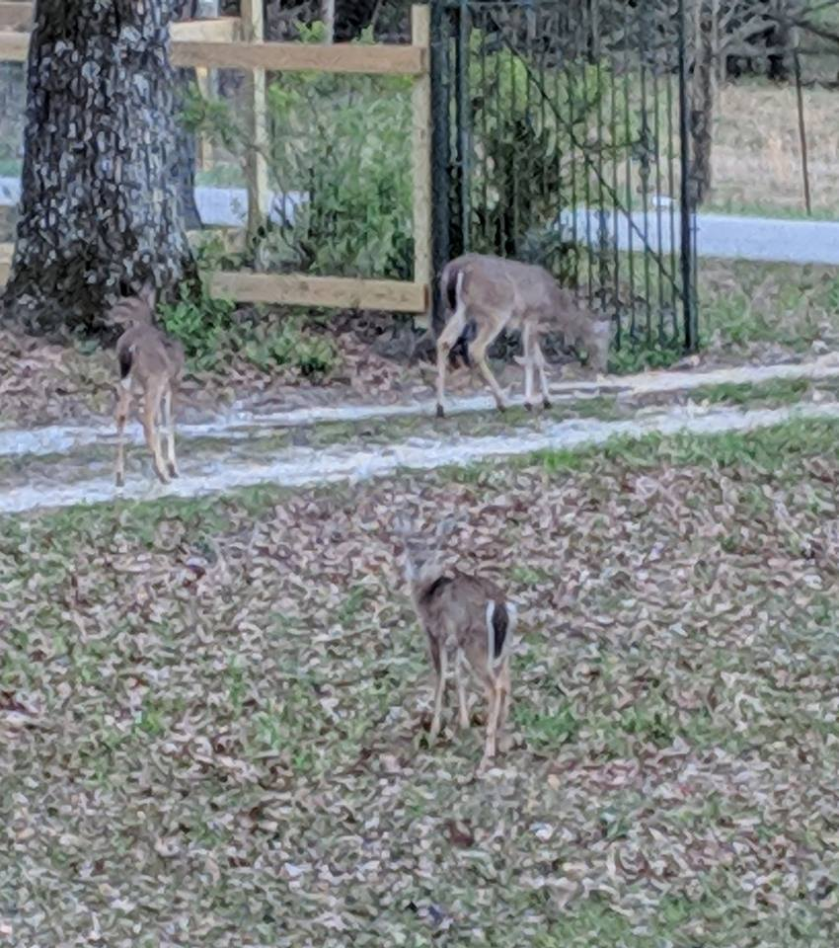
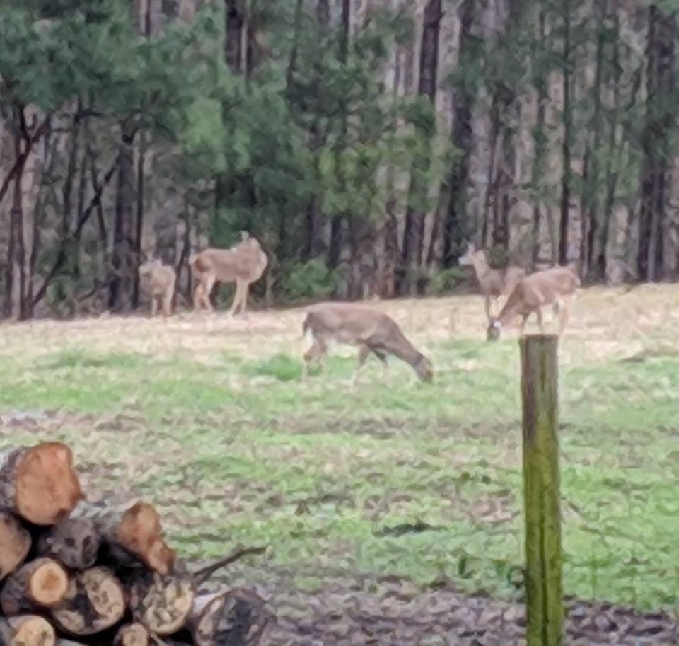
Visitors: this is an animal sanctuary—no hunting.

Slide 16
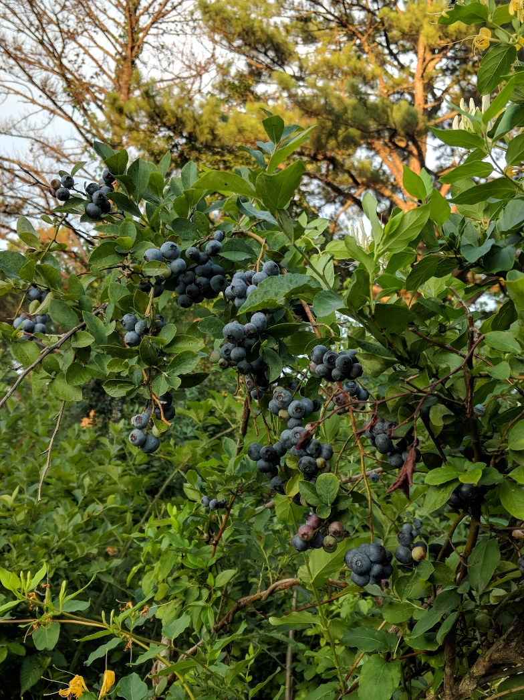
Blueberries

Slide 17
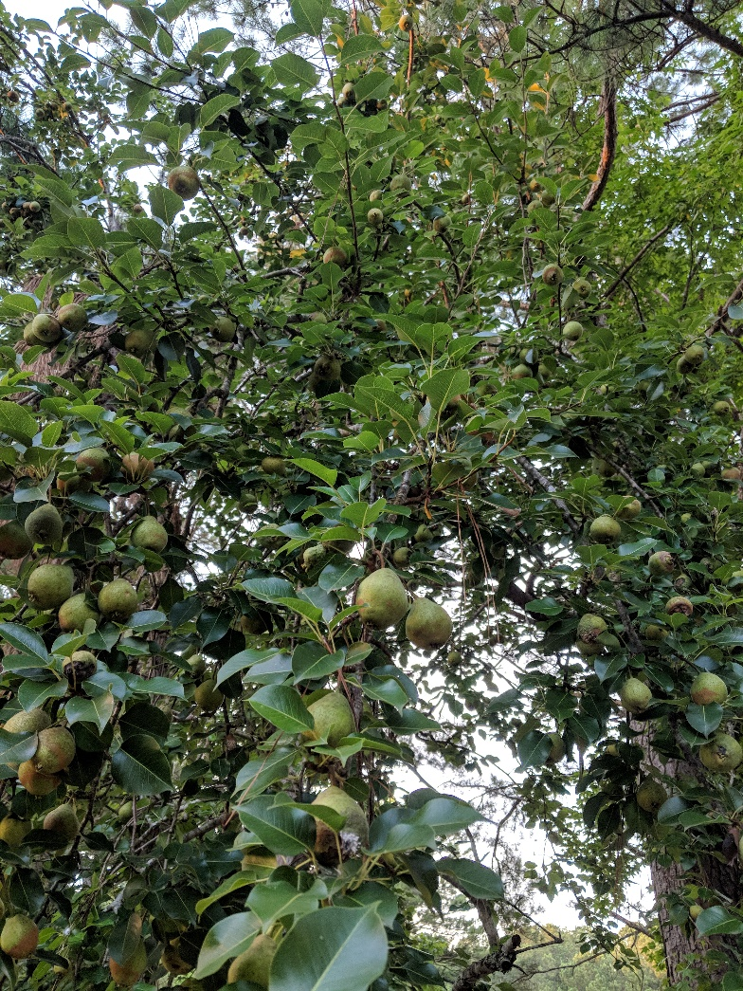
Pears

Slide 18
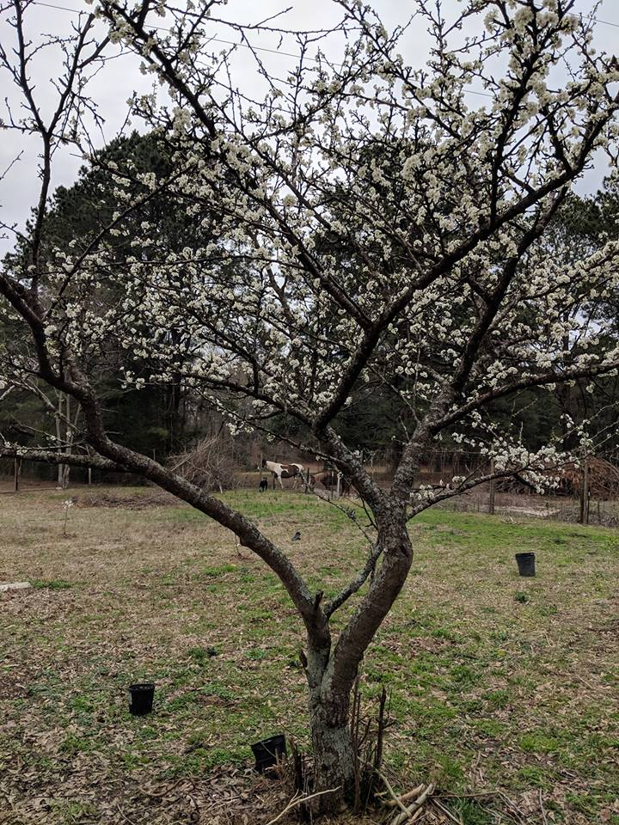
Plum Blooms, fruit Summer

Slide 19
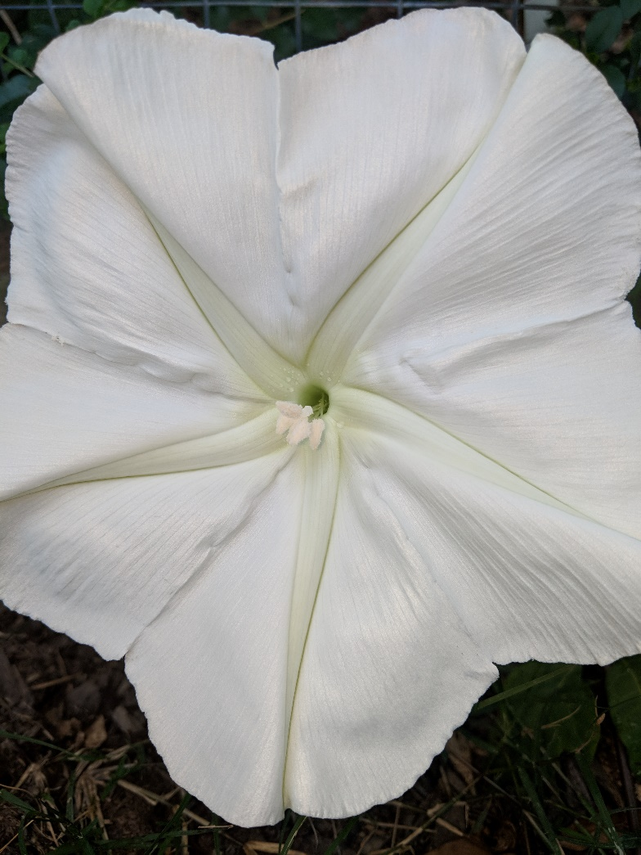
Moonflowers
(look like silk silver dollars) bloom in the evening and close during the day…. got a plant at a Botanical Garden sale 20+ years ago, and harvest seeds each fall and plant each summer.

Slide 20
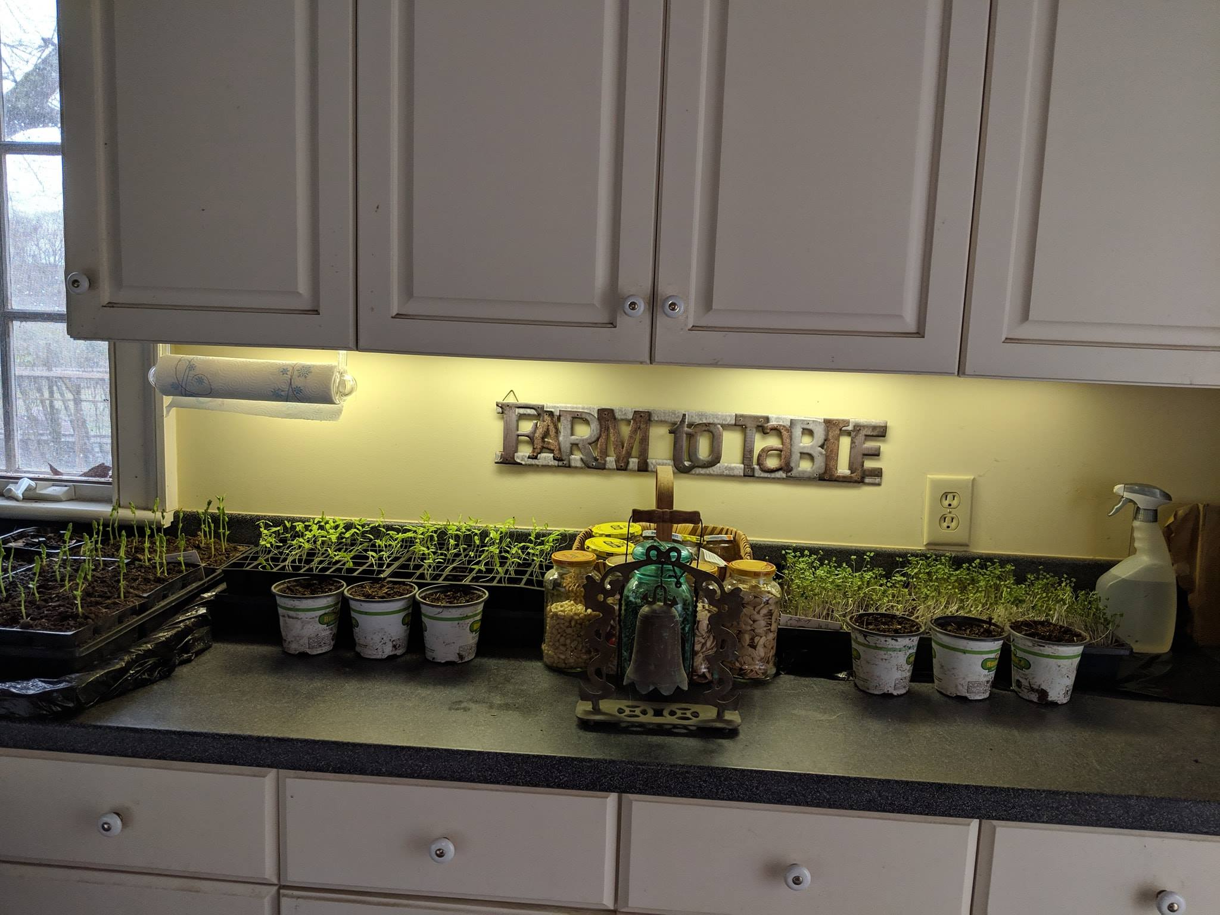
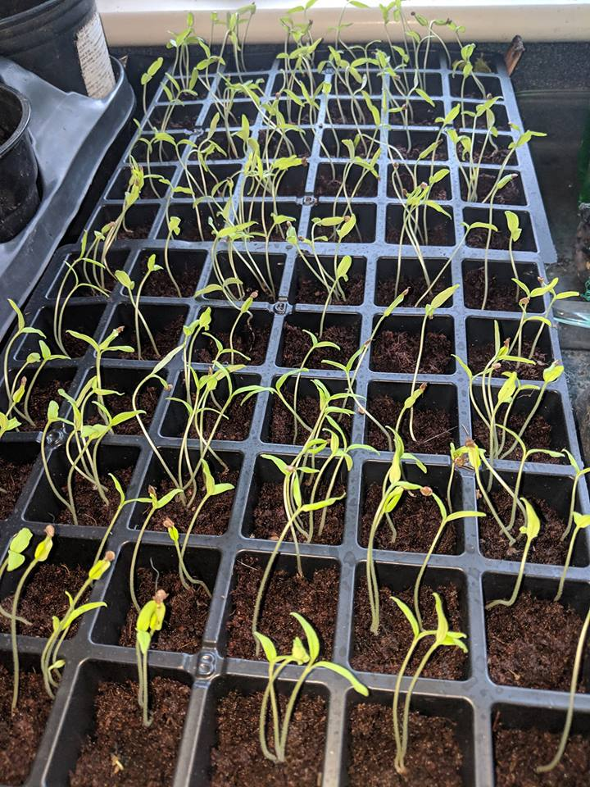
Experimented for you growing seeds inside: snow peas tomato (left center and above) microgreens germinated and growing…
Planted, no visible results—yet: eggplant, watermelon, cantaloupe…cucumber started.

Slide 21
Let’s use our planbooks
Plan, page 17
Summary pages 4-7
Pages 8-16:
income ideas: 84-101
No/low cost gardening: 141-150
reminder: you asked about ethical growing: ideas 230-236
Your questions, comments, interests—how can I help?

Slide 22
A NEW U.N. REPORT CALLS FOR URGENT ENVIRONMENTAL ACTION
A third of all edible food produced is wasted, with industrialized countries accounting for 56 percent of this waste….
Despite all of this waste, many areas of the world struggle with food security.
With a rapidly expanding global population set to hit nine to 10 billion by 2050, the U.N. calls for policymakers to improve food system productivity by 50 percent….

Slide 23
Choose to
“Be the Change You Wish to See in the World.”
Now, what will you do?

Slide 24
If you want to follow the animals and plants at Triple D Ranch and Farm
Website: TripleDRanchAndFarm.com
Facebook: Triple D Ranch and Farm
Instagram soon

